Slide 1


RF CONTROL CAR

Slide 2
Satvik Tiwari
Member
Shikhar Porwal
Member
Siddharth SIngh
Member
Saurabh Dwivedi
Leader

Slide 3

BACKGROUND
An RF-controlled car uses radio frequency signals to wirelessly control vehicle movement via a transmitter and receiver, demonstrating basic wireless communication, motor control, and embedded system operation principles.

Slide 4
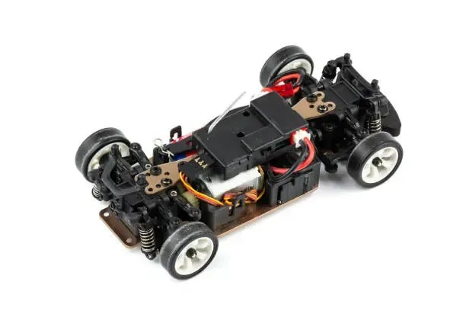
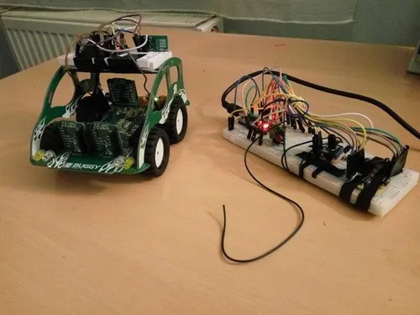
PROJECT GOALS
The project aims to design and develop a wireless car controlled via radio frequency signals.
It focuses on demonstrating efficient remote operation, motor control, and basic robotics princip

Slide 5
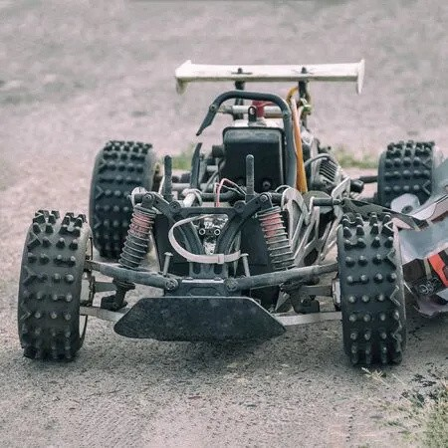
PROCESS
The transmitter sends encoded signals through the RF module to control the vehicle’s motion.
The RF-controlled car project demonstrates the practical application of wireless communication using radio frequency signals.

Slide 6
SUBJECT
The receiver decodes these signals and triggers the appropriate motors via a motor driver circuit.

Slide 7
SUBJECT 2
The car can move forward, backward, left, and right depending on user input.
This project integrates basic electronic components such as DC motors, batteries, and an RF transmitter–receiver pair.
The microcontroller or decoder IC processes the received signals to generate control outputs.
The RF system provides a reliable communication link for short distances, typically within 30–50 meters.

Slide 8
SUBJECT 3
The design emphasizes low power consumption and simple circuitry.
The system’s response is quick due to direct signal transmission without complex protocols.
However, it is susceptible to interference from other RF devices operating at the same frequency.
The project enhances understanding of signal transmission, modulation, and decoding concepts.
It also provides hands-on experience in motor control and embedded system design. Limitations include restricted range and lack of feedback from the vehicle to the controller.
Improvements can include obstacle detection, Bluetooth or Wi-Fi control, and camera integration.

Slide 9
Subject 4
The prototype serves as a foundation for developing more advanced robotic systems.
This project demonstrates how theoretical electronic principles can be applied in practical systems.
It encourages creativity, problem-solving, and hardware–software
integration skills.
The simplicity of RF communication makes it ideal for beginners in robotics and automation.
Overall, the RF-controlled car project successfully meets its goal of
showcasing efficient wireless control and basic robotics functionality.

Slide 10
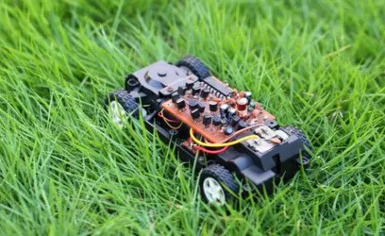
ANALYSIS
The RF-controlled car effectively demonstrates the use of radio frequency communication for remote operation.
The system’s performance depends on the strength and stability of the RF signal.
The transmitter–receiver pair successfully establishes wireless communication within a defined range.
Signal transmission was found to be reliable in open spaces but reduced in enclosed or obstructed areas.
The motor driver circuit efficiently converts control signals into mechanical motion.
Power management plays an important role in maintaining consistent performance of the motors and receiver module.
The car’s movement accuracy depends on proper synchronization between transmitter inputs and receiver responses.

Slide 11
RESULT
The RF-controlled car was successfully designed and implemented using RF transmitter and receiver modules.
The car responded accurately to remote control commands such as forward, reverse, left, and right.
The wireless communication between the transmitter and receiver worked effectively within a range of about 30–50 meters.
The motor driver circuit functioned properly, providing smooth and stable movement. Power consumption remained low, and the system operated efficiently with minimal signal delay.
The prototype proved the reliability of RF communication for short-range vehicle control. Testing confirmed consistent performance in open areas with slight interference in enclosed environments.
Overall, the project successfully demonstrated the principles of wireless communication, signal processing, and motor control in a small robotic vehicle.

Slide 12
CONCLUSION
The RF-controlled car project successfully demonstrated the practical use of radio frequency technology for wireless vehicle control. The system efficiently transmitted commands from the transmitter to the receiver, enabling smooth movement in all directions. It provided hands-on experience with concepts such as wireless communication, motor control, and embedded electronics.
Although the range and signal interference present minor limitations, the project effectively achieved its objectives of showcasing remote operation and control system design. This work serves as a foundation for developing more advanced wireless or autonomous robotic systems using technologies like Bluetooth, Wi-Fi, or IoT integration.

Slide 13
THANK YOU

